Slide 1
Designing an Object Detection System
Group 4

Slide 2
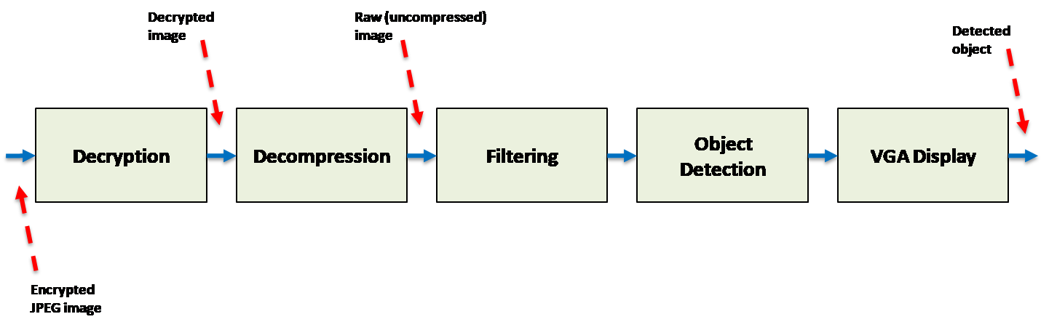
Introduction
Hardware Trivium Solution
Hardware Filtering Solution
OpenCV Shape Detection
OpenCV Filtering

Slide 3
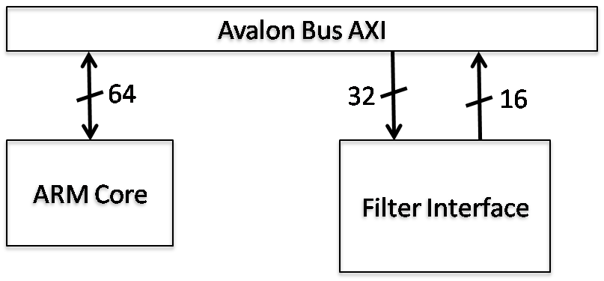
Filtering
807s -> 465s

Slide 4
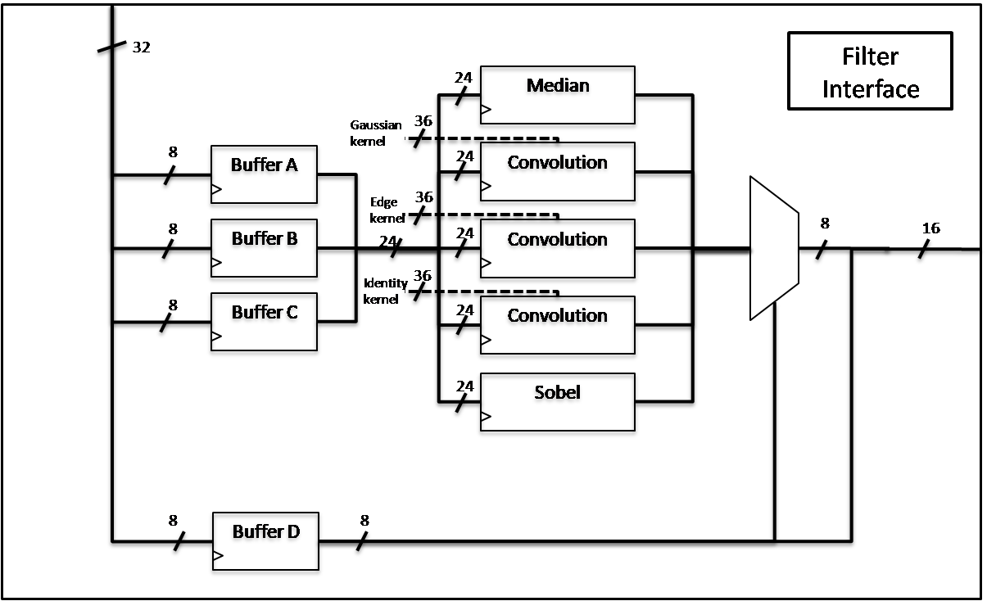
Hardware Pipelining
465s -> 150s

Slide 5
ID Tags
Filter type bits | Filter
000 | Edge filter
001 | Gaussian filter
010 | Identity filter
011 | Median filter
100 | Sobel filter
101-111 | Reserved
ID Tag – 8 bits
First 3 bits identify filter type
Last 5 bits is the number of the packet
ID Tag
0 | 1 | 1 | 0 | 0 | 0 | 0 | 0 | 1
Filter type
Packet number

Slide 6

Object Detection
OpenCV libraries for C++
Modified software to compile using g++
Shape detection
Detects edges, determines if edges define a shape, determines what shape

Slide 7
OpenCV Filtering
OpenCV libraries contain filtering functions
These functions are far faster than our hardware implementations
Sobel filtering twice in a row gives a blank image
150s -> 0.13s

Slide 8
VGA Cache Access
Array was being accessed using a column-major logic
Caused a lot of cache misses since C uses row-major logic
Observed a time improvement of 13.82% afterwards

Slide 9
Performance Improvements
Filtering Stage
807s -> 465s -> 150s -> 0.13s
VGA Output Stage
100s -> 87s
Total Run Time
904s (1 FPS) -> 48s (19 FPS)
All measurements via gprof

Slide 10
Future Work
Hardware filter daisy chaining
Multithreaded dual-core
24 bit colour
Luminance

